Slide 1
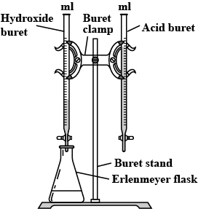
Acid Base Quiz - Post Review
Titration & Neutralization
By Jeff Christopherson

Slide 2
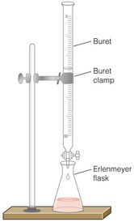
What volume in milliliters of 0.00300 M HCl is required to neutralize 30.0 mL of 0.00100 M Ca(OH)₂ solution?
2 HCl + Ca(OH)₂ → CaCl₂ + 2 H₂O
M₁V₁ = M₂V₂
X mL 0.003 M
30 mL 0.001 M
(0.003 M)(x mL) = (0.001 M)(30 mL)
X = 10 mL
amount of ACID = amount of BASE
M V # = M V #
(0.003 M) (x mL) (1) = (0.001 M)(30 mL)(2)
x = 20 mL of 0.00300 M HCl
WRONG
HCl H⁺ + Cl⁻
# = 1
0.003 M
0.003 M
M₁V₁ = M₂V₂
Ca(OH)₂ Ca²⁺ + 2OH⁻
# = 2
(0.003 M)(x mL) = (“0.002 M”)(30 mL)
0.001 M
0.001 M
“0.002 M”
X = 20 mL
“Correct”
What would the pH be at this point?
7.0

Slide 3
0.472 M nitric acid was used to titrate a 0.388 M aluminum hydroxide solution. The initial volume reading on the acid buret was 34.42 mL and the final reading was 41.90 mL.
If the initial reading on the base buret was 63.25 mL, what was the final volume reading on the base?
41.90 mL – 34.42 mL = 7.48 mL
Acid Base
moles of acid = moles of base
M V # = M V #
(0.472 M) (7.48 mL) (1) = (0.388 M)(x mL) (3)
X = 3.03 mL of 0.388 M Al(OH)₃
# = 1
HNO₃ → H⁺ + NO₃⁻
0.472 M
0.472 M
# = 3
Al(OH)₃ → Al³⁺ + 3 OH⁻
0.388 M
0.388 M
“1.164 M”
If using M V = M V
63.25 mL + 3.03 mL = 66.28 mL
(0.472 M)(7.48 mL) = (1.164 M) (x mL)
X = 3.03 mL added base

Slide 4
Calculate the molarity of a H₂SO₄ solution if 35.0 mL of the solution is neutralized by 75.0 mL of 0.265 M NaOH.
H₂SO₄ (aq) + 2 NaOH (aq) → Na₂SO₄ (aq) + 2 H₂O (l)
# = 2
H₂SO₄ → 2 H⁺ + SO₄²⁻
# = 1
NaOH → Na⁺ + 1 OH⁻
0.265 M
0.265 M
0.265 M
“amount” of Acid = “amount” of Base
M V # = M V #
(x M) (35 mL) (2) = (0.265M)(75 mL)(1)
x = 0.2839 M H₂SO₄

Slide 5
1000 mL = 1 L
What is the molarity of nitric acid if 24.62 mL is required to neutralize 1.750 g of sodium oxalate, Na₂C₂O₄?
2 HNO₃ + Na₂C₂O₄ → H₂C₂O₄ + 2 NaNO₃
acid
base
CA
CB
X mol HNO₃ = 1.750 g Na₂C₂O₄
1 mol Na₂C₂O₄
2 mol HNO₃
= 0.02612 mol HNO₃
134 g Na₂C₂O₄
1 mol Na₂C₂O₄
M
0.02612 mol
mol
mol
L
M
L
M =
M =
0.002462 L
M_{HNO3} = 10.61 M

